Slide 1
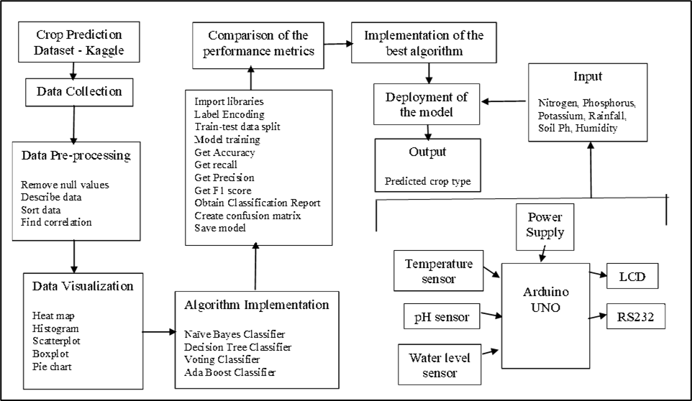
System Architecture Diagram

